Slide 1
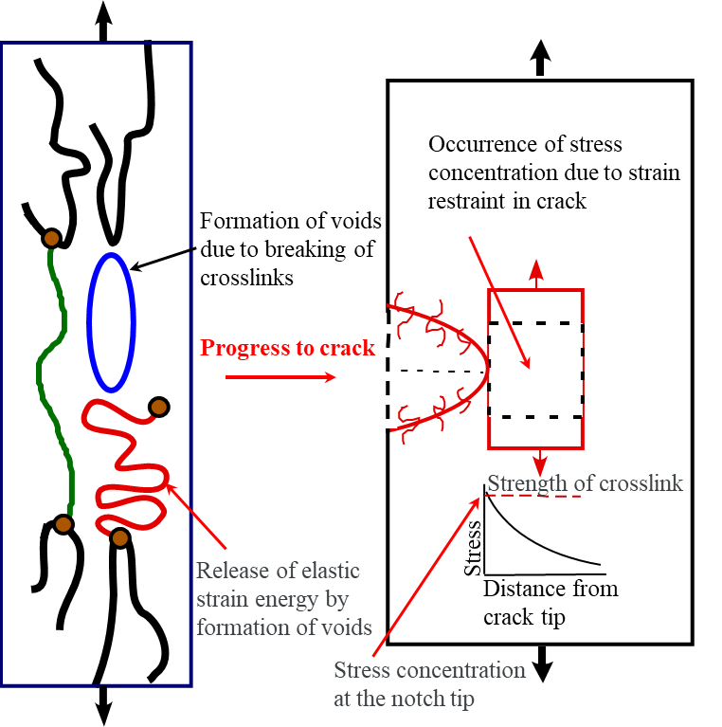
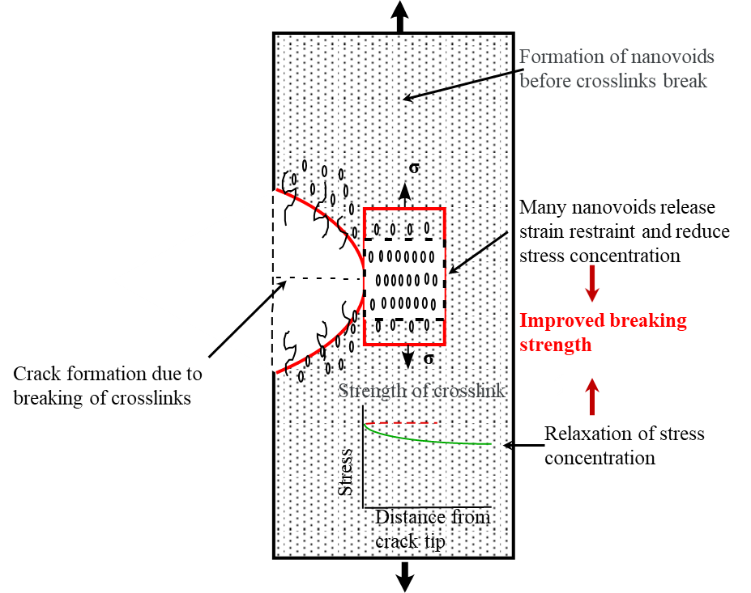
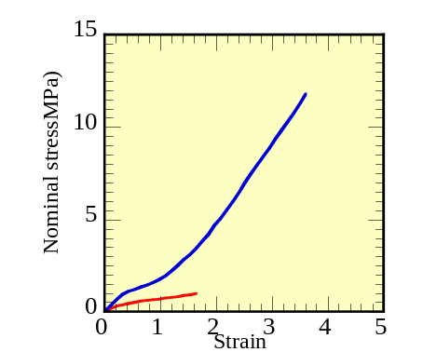
Improvement of strength of pure rubber by filling with CB
Pure rubber
CB filled rubber
Stress-strain curves
CB filled rubber
σ
Pure rubber
SC=120～200
σ
SC=20
SC : Guideline of stress concentration

