Slide 1
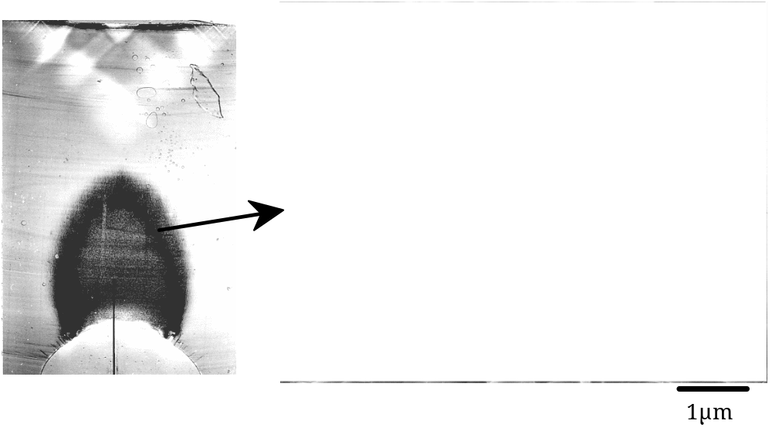
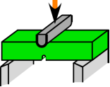
10phr
4
Plastic zone
Void
PVC
6
8

